Slide 1


Slide 2
String

Slide 3
Contents:
StringBuffer
StringBuilder
StringBuffer vs String Builder
Methods of Strings

Slide 4

StringBuffer
StringBuffer append() method
StringBuffer insert() method
StringBuffer replace() method

Slide 5
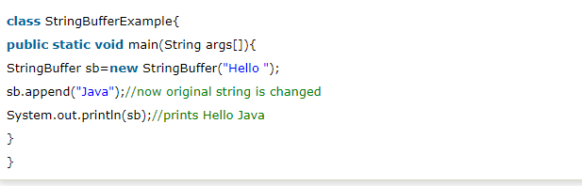
StringBuffer append() method

Slide 6
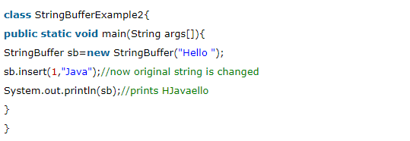
StringBuffer insert() method

Slide 7
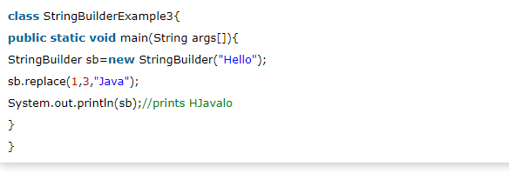
StringBuffer replace() method

Slide 8
StringBuilder
StringBuilder delete() method
StringBuilder reverse() method
StringBuilder capacity() method

Slide 9
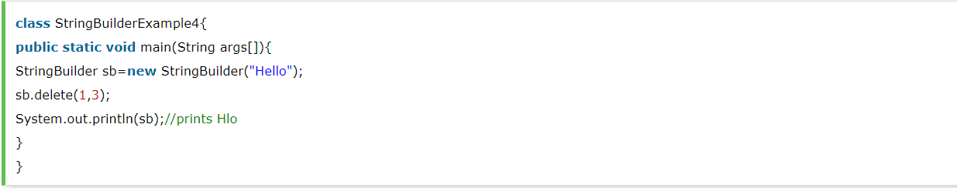
StringBuilder delete() method

Slide 10
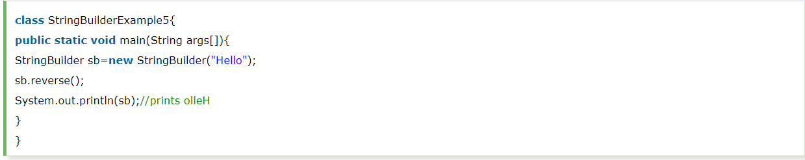
StringBuilder reverse() method

Slide 11
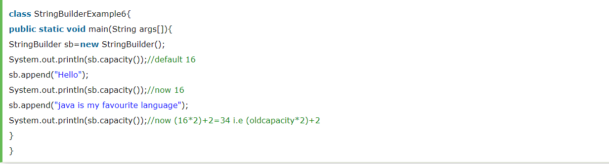
StringBuilder capacity() method

Slide 12
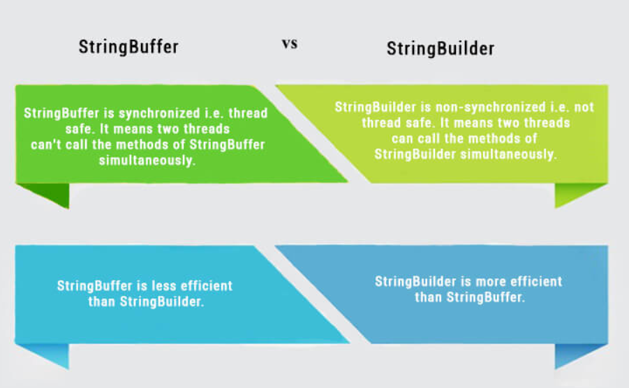
StringBuffer vs StringBuilder

Slide 13
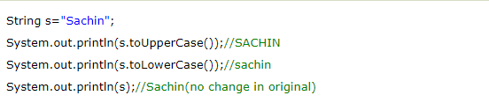
Methods Of String
Java String toUpperCase() and toLowerCase() method:

Slide 14

Java String trim() method

Slide 15

Java String charAt() method

Slide 16
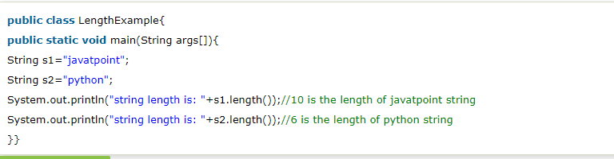
Java String length() method

Slide 17


